Slide 1
Data centres
This file contains snippets of graphs and things I found interesting or useful in crafting the projections of growth rates, new capacity, intensity, ai/data-centre capacity ratios and so on.

Slide 2
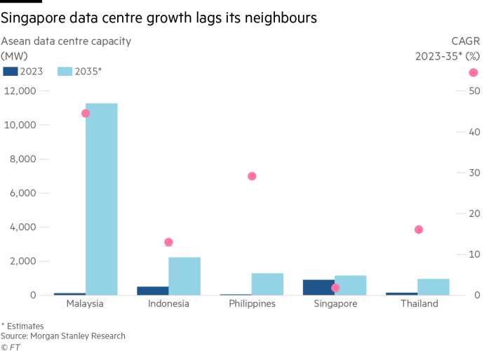
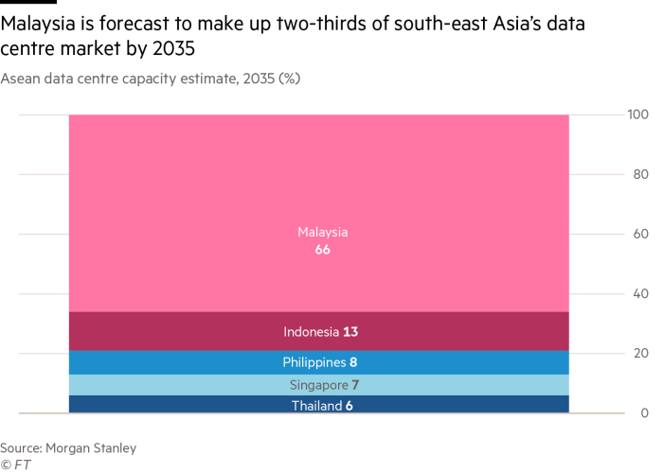

Slide 3
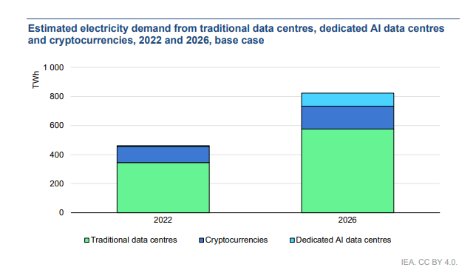
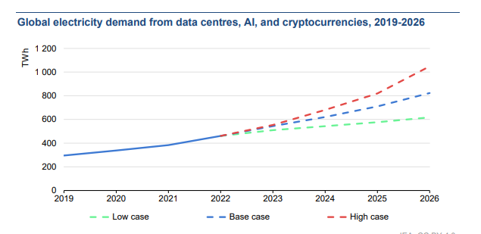
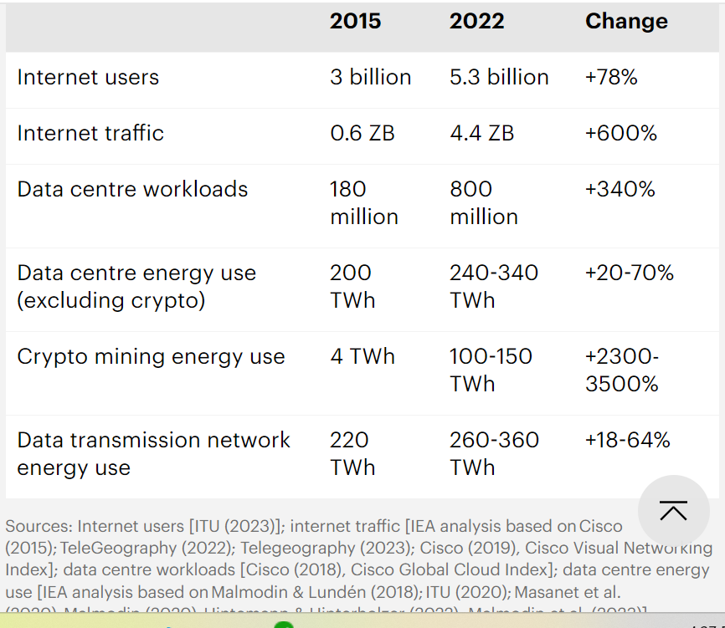
Iea – think its found by searching up ‘iea datacentres’

Slide 4
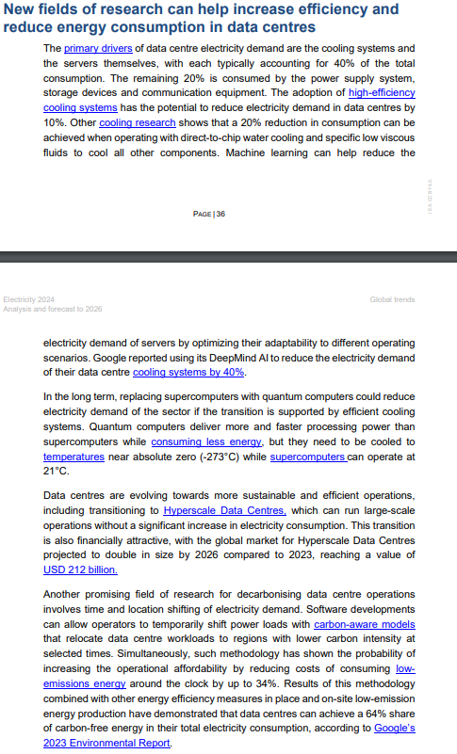
Iea cont.

Slide 5
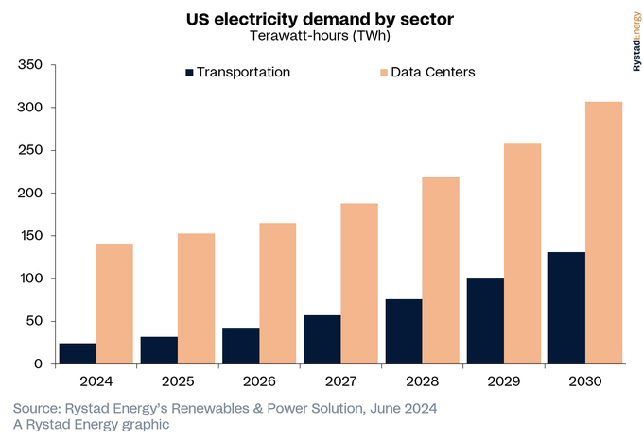

Slide 6
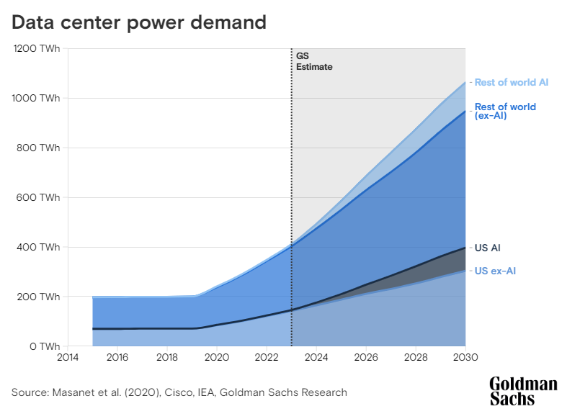

Slide 7
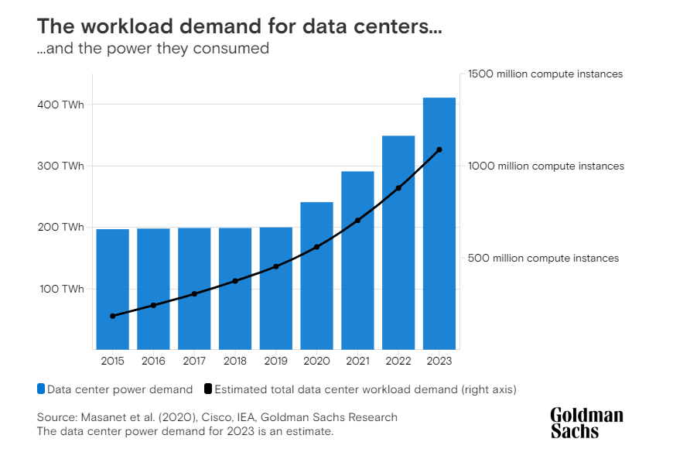

Slide 8
Important topics we could mention in discussion
Centralised/decentralized generation capacity for data centres.
If it is centralized it will help to encourage investment but cause short term issues with prices as supply is not available
If decentralized, we may see issues with pre-existing capacity being taken off the grid resulting in increased transmission costs for remaining consumers but it also may result in an increase in development of renewable baseload technology, which can be used for the main grid too/
Demand response ability/flexibility of data centres

Slide 9
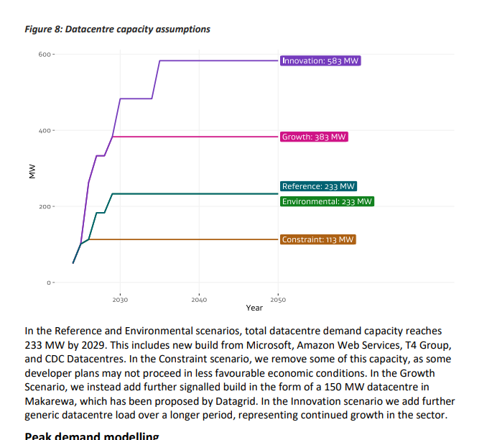
Nz edgs scenarios modelling

Slide 10
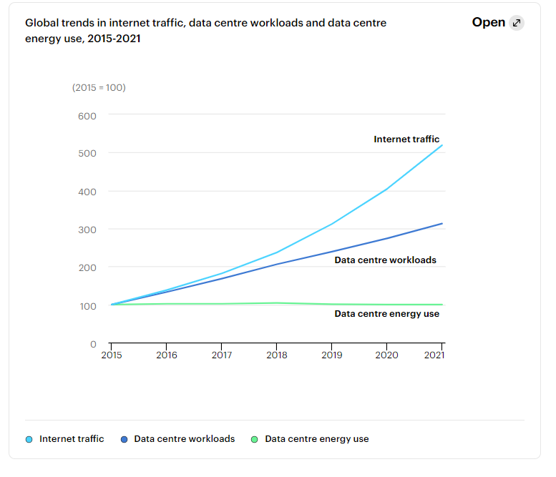
iea

Slide 11
Ideas for modelling
Split into 2 kinds:
Ai training and Cryptocurrencies
Based on trends and could be demand response enabled
Note that ai training is only 30% of the energy use associated with ai. 10% more for model development and testing, then 60% for use and inference. So this is really a small amount and not as important to consider?
General Data Center Usage (e.g. google/Netflix)
Majority of demand. Not flexible.
Includes use of ai tools (i.e. inference), but not training of them.
Can be estimated using an estimate of total data use per person annuallyand the amount of data they use, up to a threshold. > but what about organisations? Surely they would use more? > is commercial use of data related to gdp instead?
Previously we would have accounted for businesses computing as in house elec use, but now with cloud computing, vide conferencing, and ai, we’ll probably see more and more data use from businesses.
If we use growth to 2030 from graph in next page, the question becomes, what will happen after 2030. some factors to consider:
Market Saturation
Efficiency gains
New use cases (i.e. 6g which represents the advancement of current technology, not increasing to 6gb of capacitlity or whatever)
To me it seems like activity continues to increase forever, representing the advancement of technology. Efficiency will continue to improve but with decreasing effectiveness.
Could try calaculate a representation of activity which is based on data requirements for population and then other things for services?

Slide 12
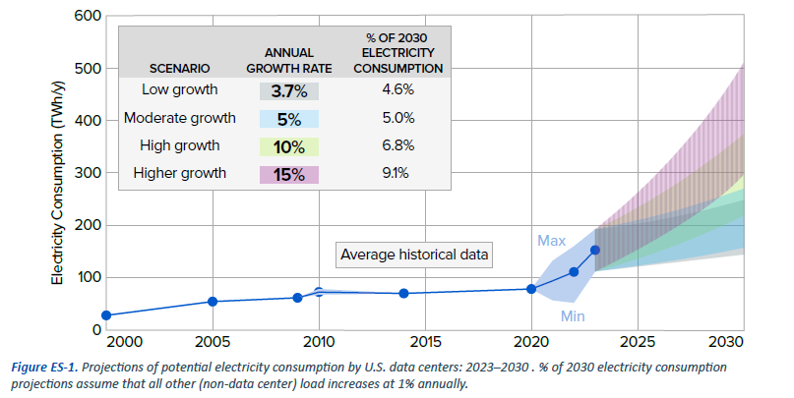

Slide 13
NOTES
Data centers favor sites where internet connections are strong; where electricity prices, land costs, and disruptive events are low; where skilled labor is available; near population centers and users; and where the centers can develop backup power to ensure power supply (usually natural gas or diesel generators).
Key questions:
As the number and size of data centers expand to support continued growth in data processing, internet traffic, and rapid expansion in artificial intelligence (AI) applications, some critical questions emerge:
How rapidly can we expect data centers to expand, and how does the rapid growth in AI change their power demands?
What is the impact of these developments on electric load and resource adequacy?
What implications do these trends have for future electricity infrastructure planning?
How can the data center and electric utility industries work together to support rapid data center expansion?

Slide 14
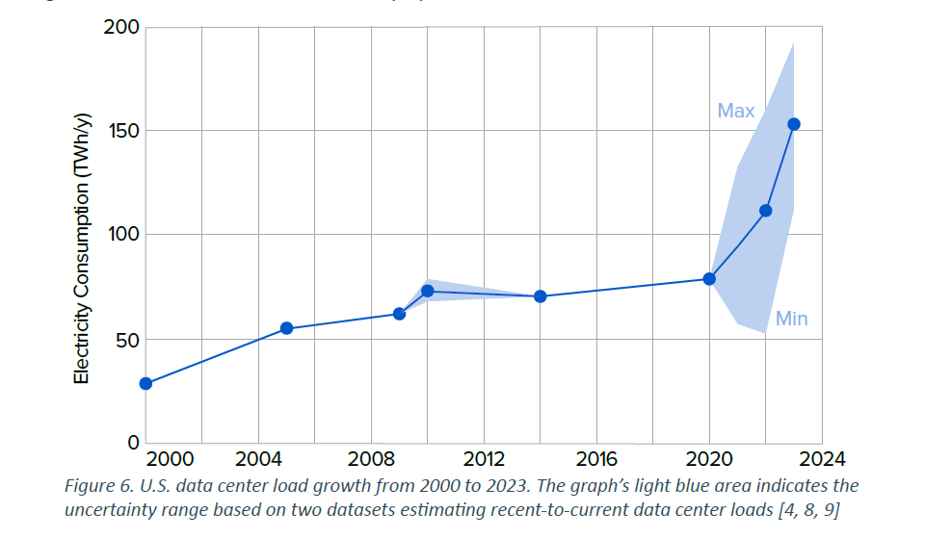
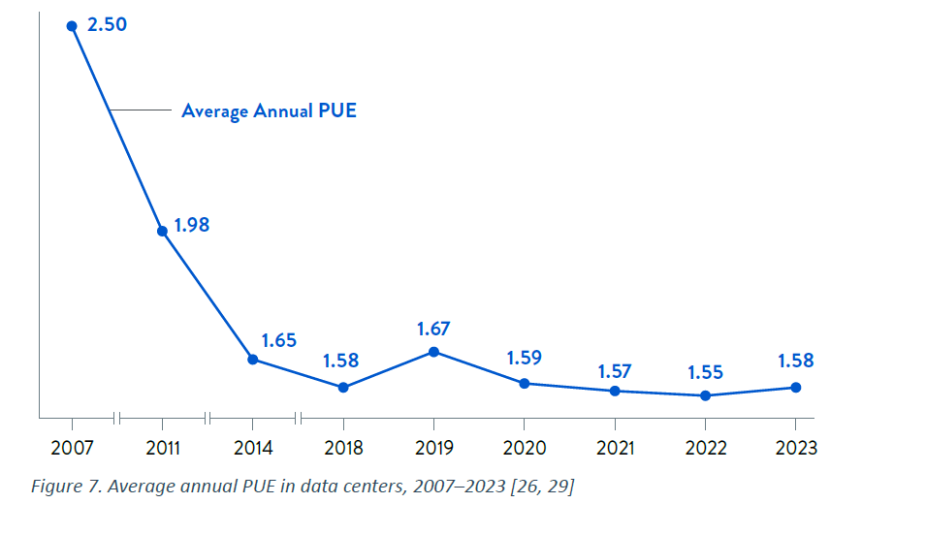

Slide 15
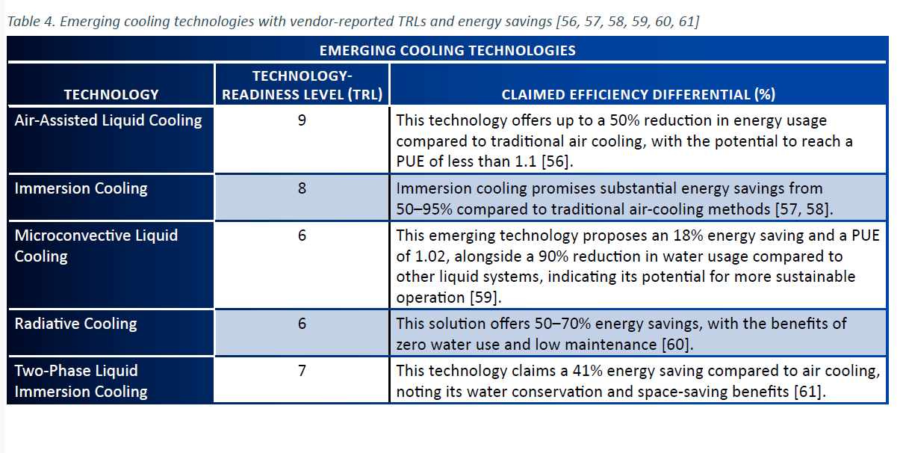

Slide 16
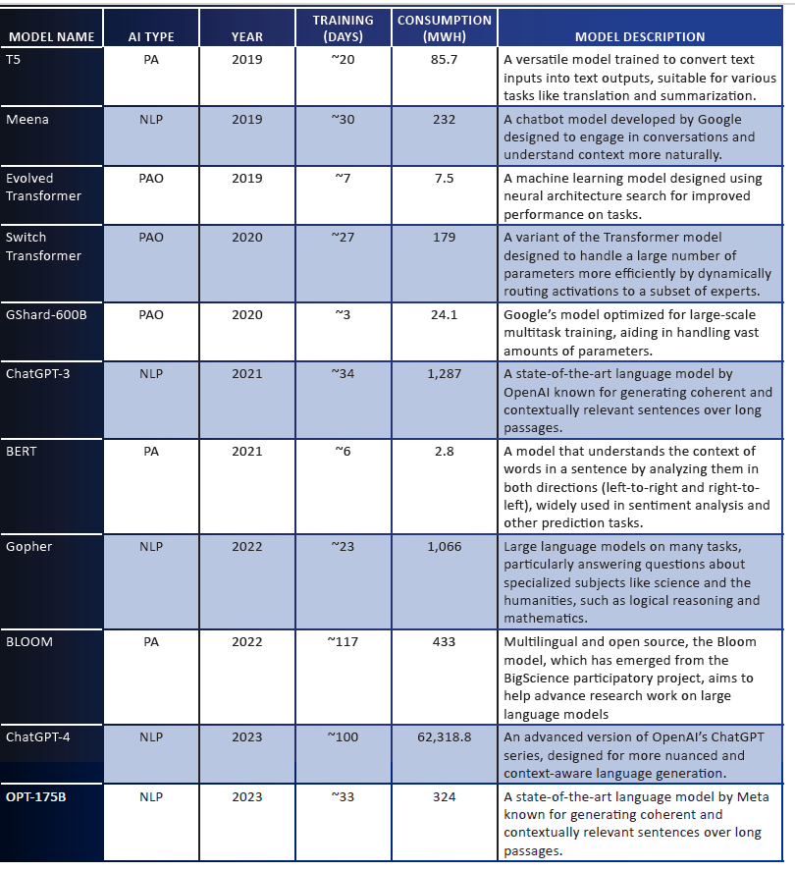

Slide 17
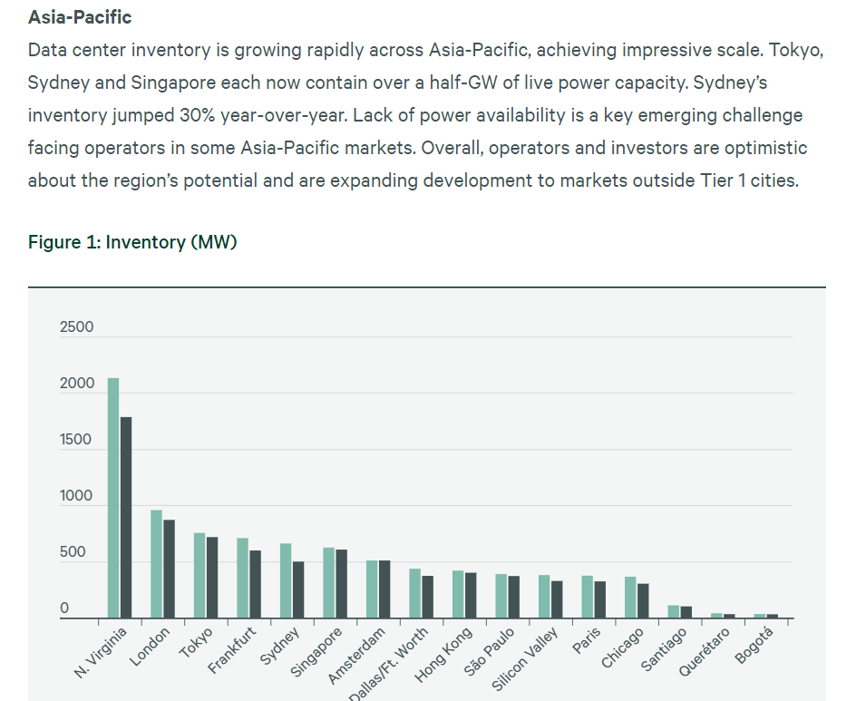
https://www.cbre.com/insights/reports/global-data-center-trends-2023 - this report had a lot of info including a summary of current states of many asia pacific nations with data centres

Slide 18
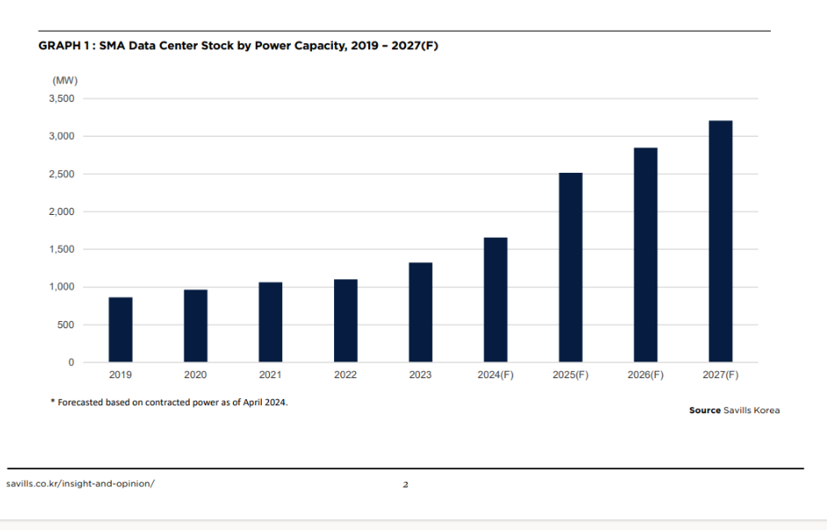

Slide 19
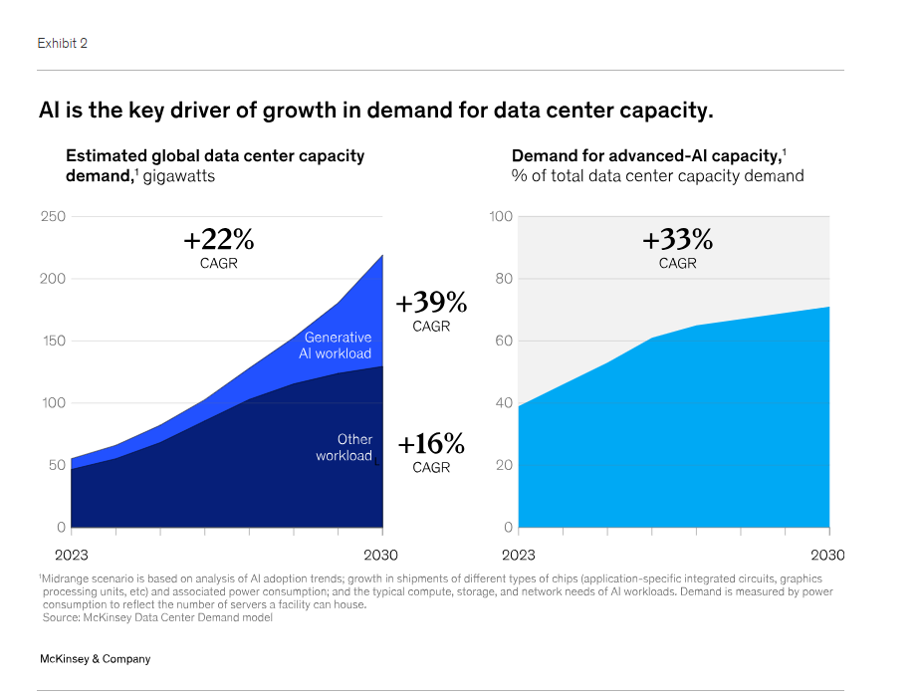

Slide 20
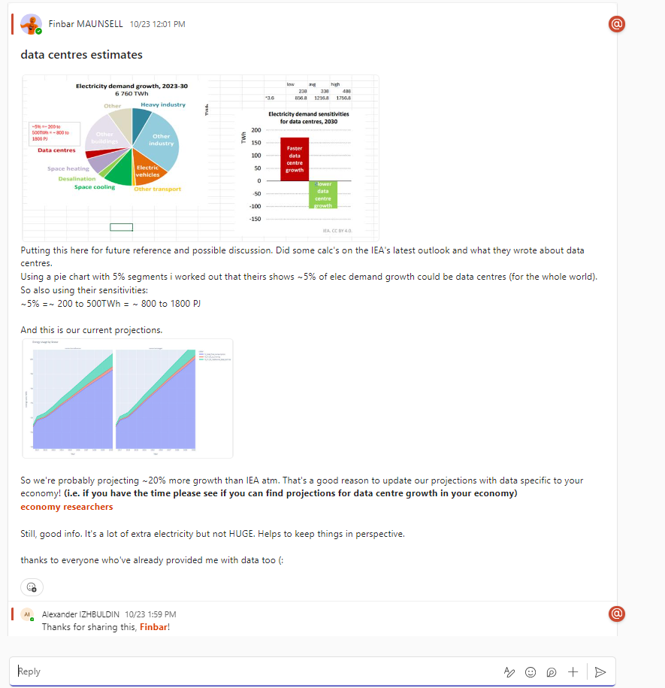

Slide 21
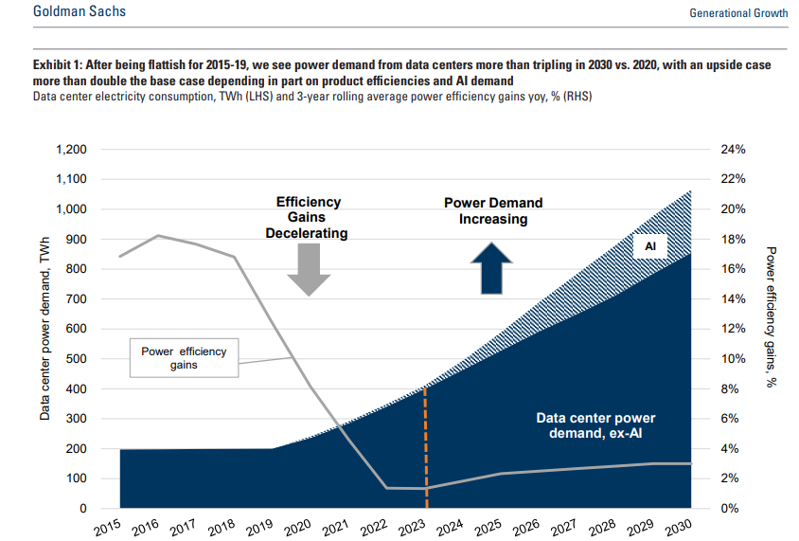
Hi, just as a first estiamte to help understand the general trajectory of aperc total data centres demand i have done USA's projection using this G-Sachs report from May this year:
https://www.goldmansachs.com/pdfs/insights/pages/generational-growth-ai-data-centers-and-the-coming-us-power-surge/report.pdf
Note 1050 twh is 3780pj, 200 twh is 720pj , 850 twh is 3060pj

